Slide 1
Programming the Prism-IPX Fire Station Alerting Solution

Slide 2
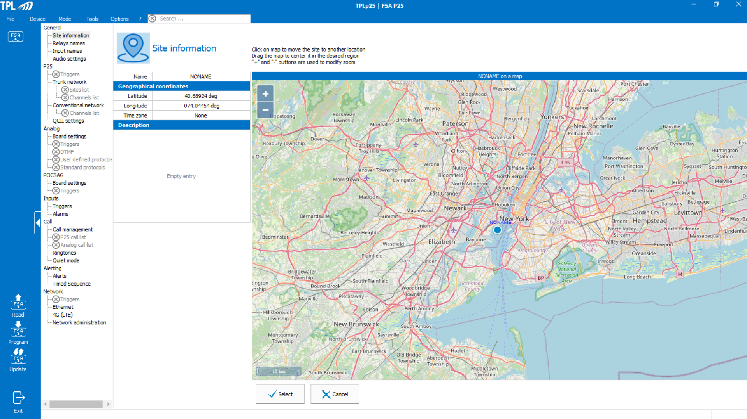
Downloading the Programming Application
Go to the link https://www.dropbox.com/scl/fi/jq4o8j3lxymxjkwm7vwpb/setup_TPLp25_1.01.7.3.zip?rlkey=n0i2l80lpcc6sna64l8c4n7c7&dl=0 to download the Programming application to either your Desktop or other location,
It is a Zip file so extract it.
Once extracted find the programming application (it is setup_TPLp25_1.01.7.3).
Double click on it to launch it and follow all the instructions.
Once launched you will see the below. In the next series of slides all the FSA settings will be reviewed.

Slide 3
Site Information
Here one can identify the FSA’s location by giving its location a name and adding in the GPS coordinates.
The Time Zone setting is an important parameter as it is used for the Quiet Mode time based settings to be reviewed in slide 28

Slide 4
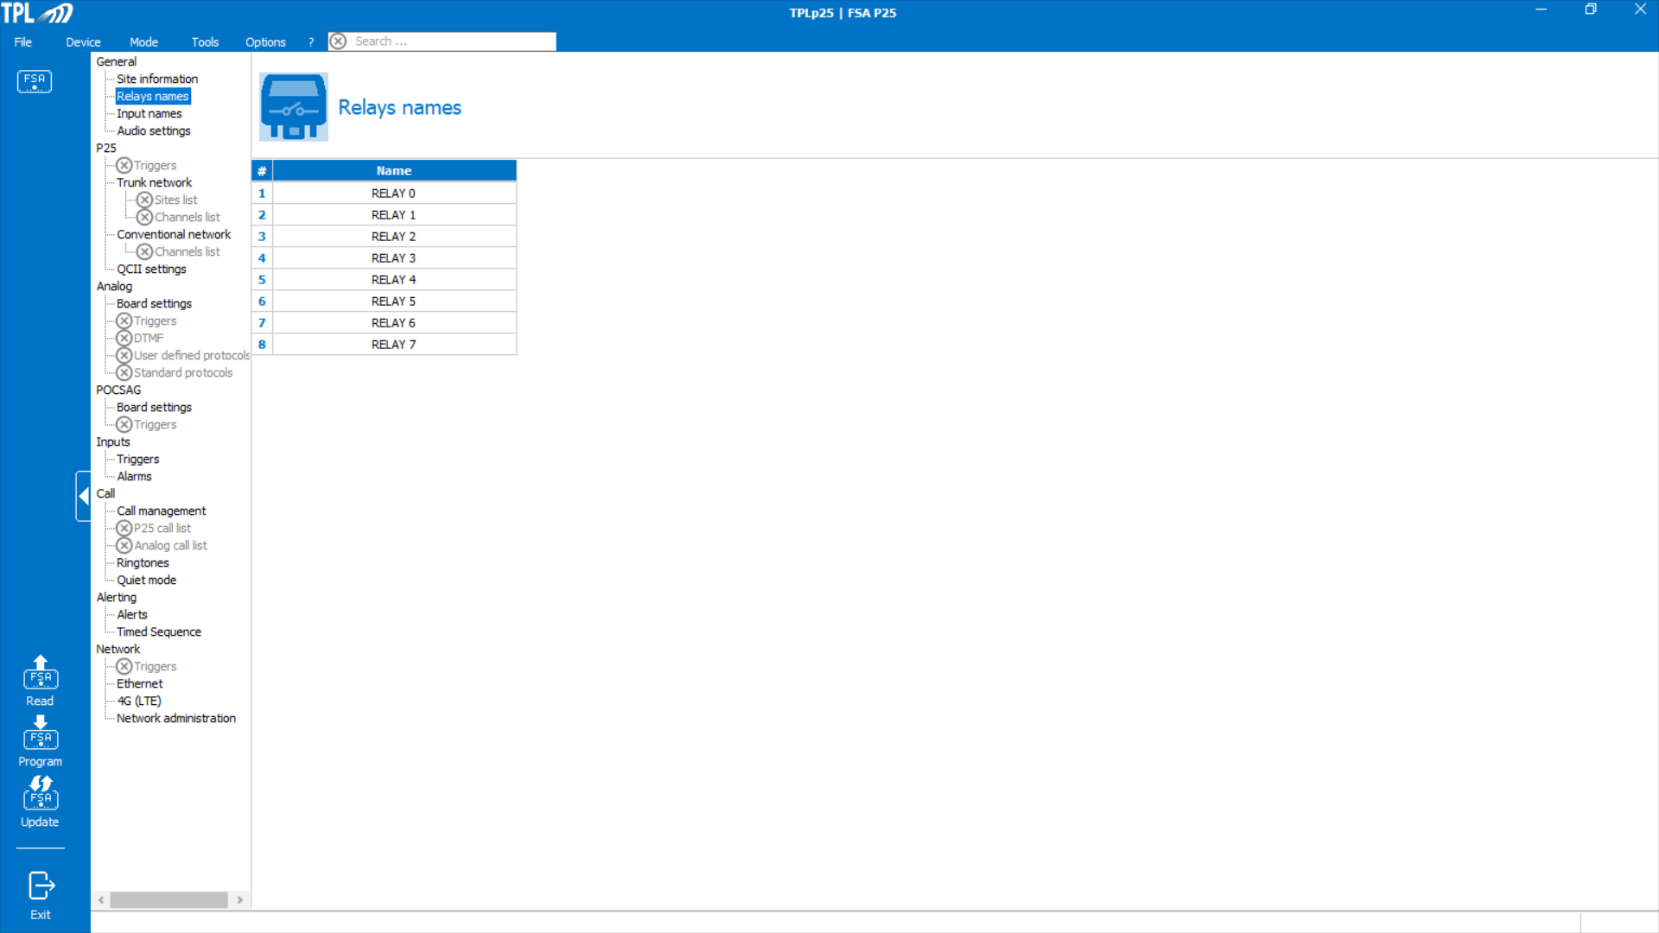
Relay Names
The FSA has eight (8) , 8 amp, relay outputs. In this list one can identify each relay and its purpose.

Slide 5
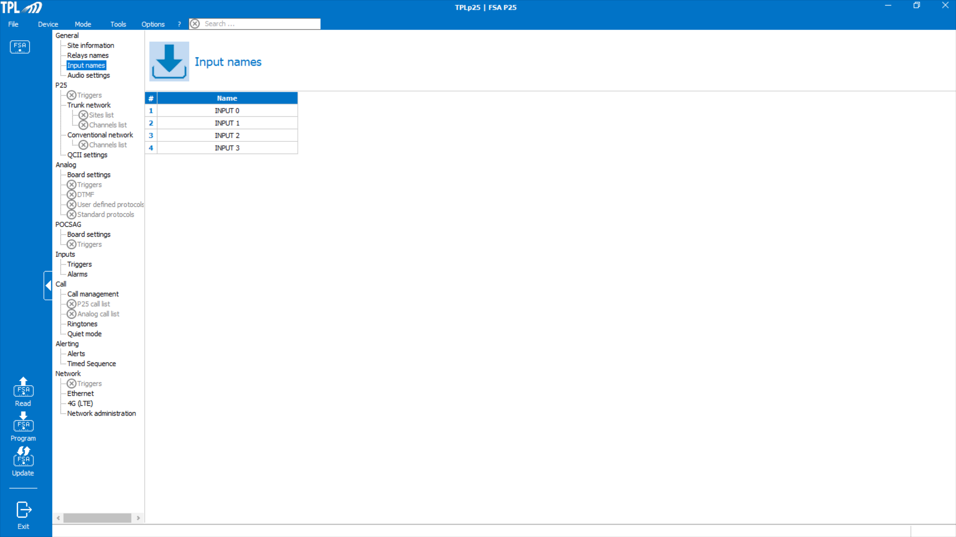
Input Names
The FSA has four (4) Inputs. These inputs can be used to manually activate relays or control the Quiet Mode (refer to slide 28).
Here, one can assign a name to each Input.

Slide 6
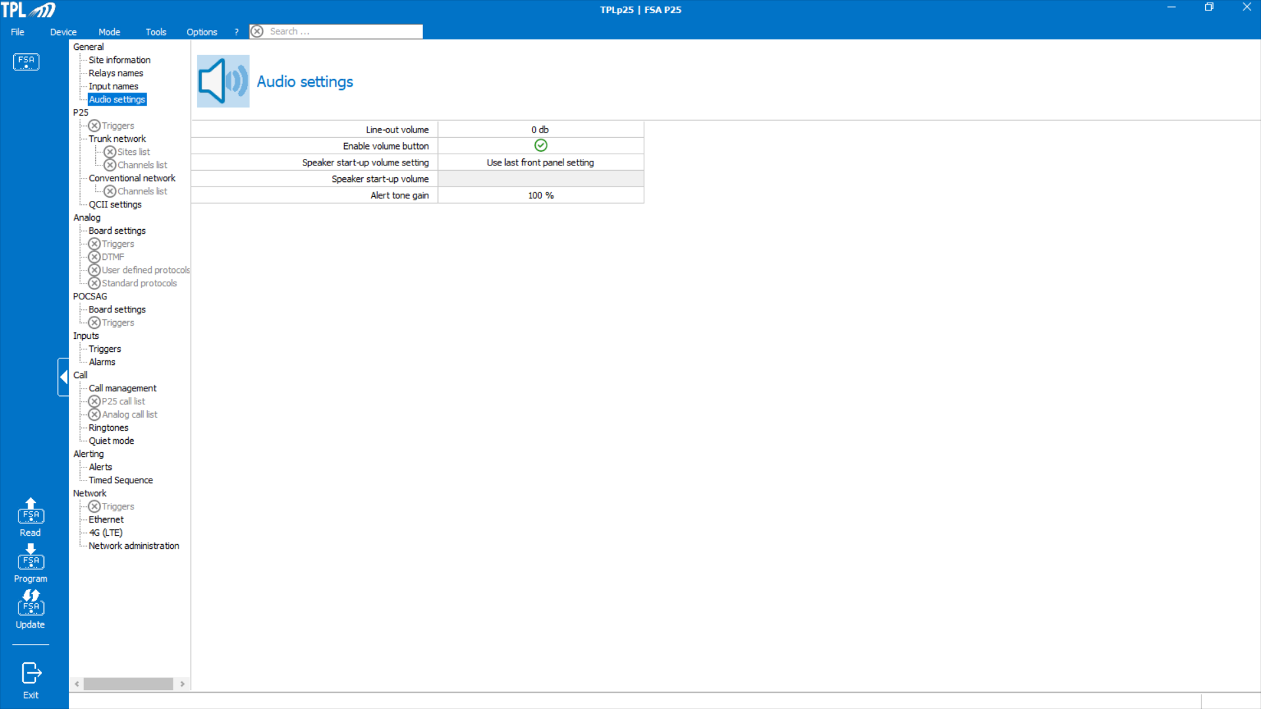
Audio Settings
This screen is used to program the audio settings for the 600 Ohm audio output and the front panel speaker. The settings are:
Line-Out- this sets the audio level output of the 600 Ohm output. Maximum setting it +5dB.
Enable Volume knob- the front panel speaker volume settings can be enable or disabled.
Speaker Start-up-can be manually set or a programmed value.
Alert Tone Gain-Allows one to adjust the alert tone volume relative to the audio. Maximum setting is 150%.

Slide 7
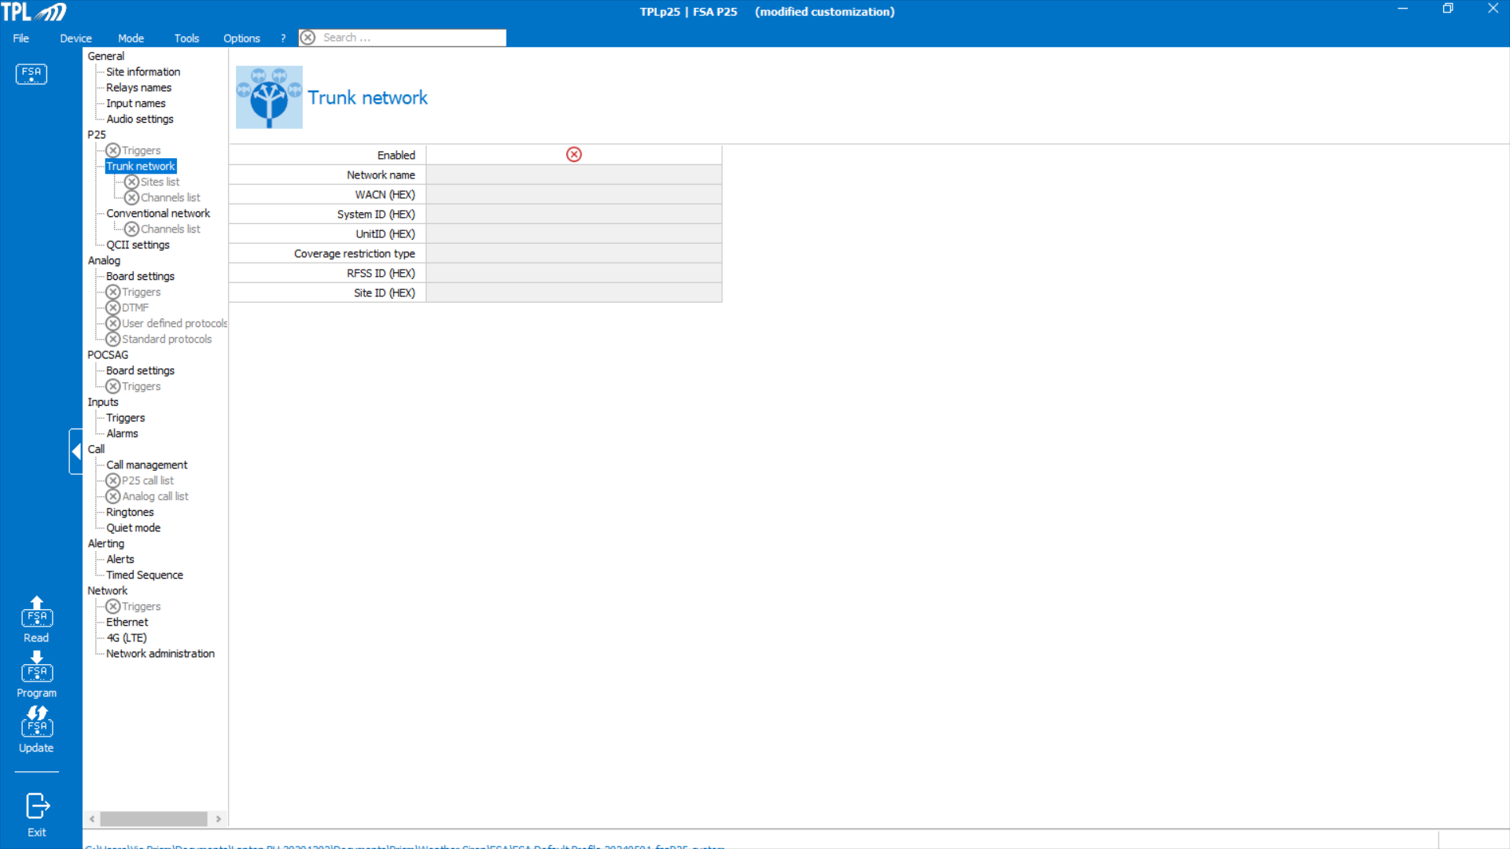
P25 Settings
In the P25 section one first has to define either the Trunking Network or the Conventional Network. In the following slides both Trunking and Conventional settings will be reviewed.

Slide 8
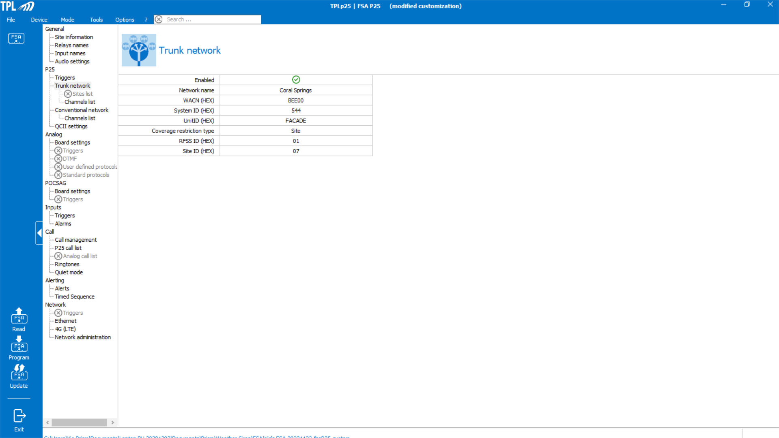
P25 Trunk Settings
Network Name- this will be used as one assigns the triggers.
WACN and System ID- these are critical parameters that are unique for each Trunked system.
UnitID- Leave this setting to the default value (FAÇADE).
Coverage Restriction type- this is a very important parameter and has to be coordinated with the System Administrator to ensure the FSA is monitoring the correct Site or Sites. There are multiple choices but only use Site or Multi-Site.
RFSS and Site ID- if Site was selected in the above setting then these two parameters can be entered.
If Multi-Site is selected then one has to go to the Sites List, refer to the next slide.

Slide 9
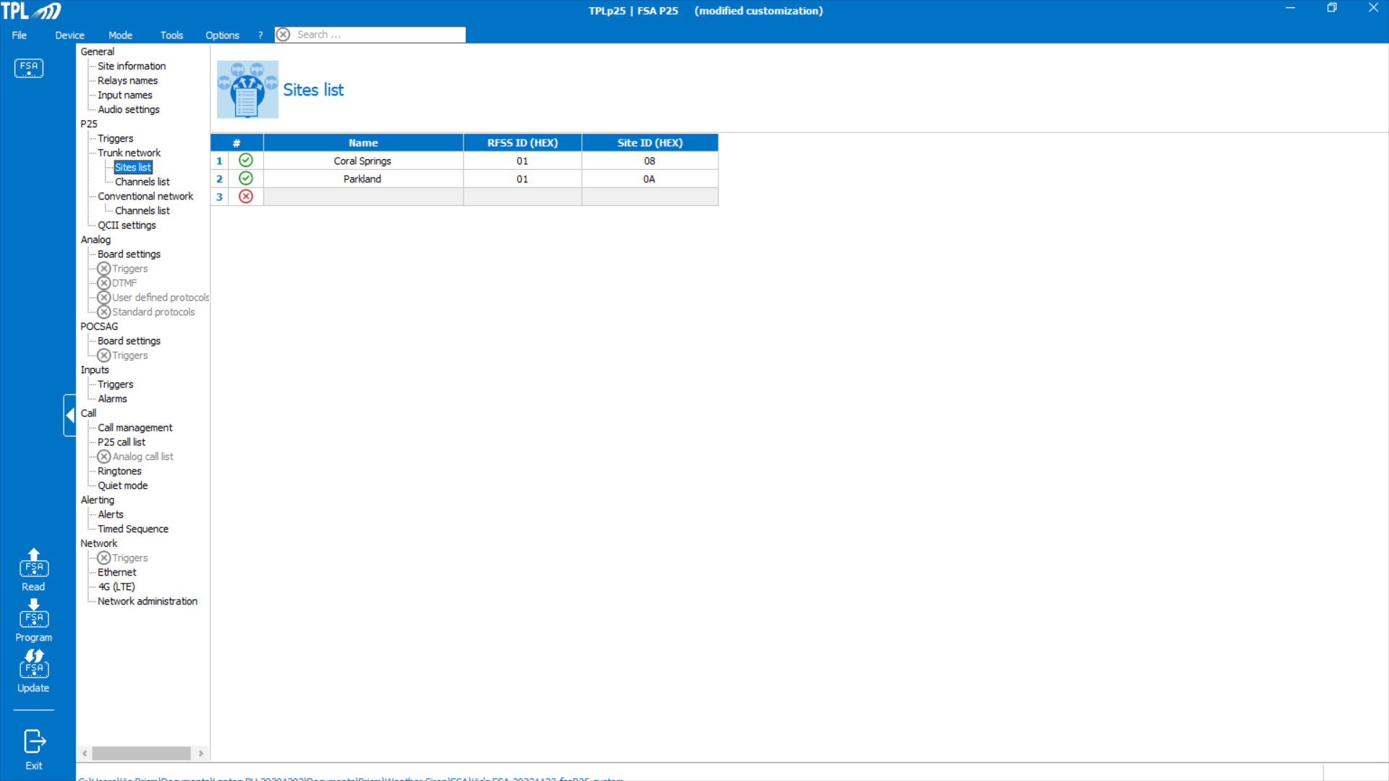
P25 Sites List
If Multi-Site is selected as the Coverage restriction type this screen can be accessed. It is critical that only the Sites where traffic specific for the FSA are transmitted over are assigned. This has to be coordinated with the System Administrator.
Up to 10 Sites can be entered.

Slide 10
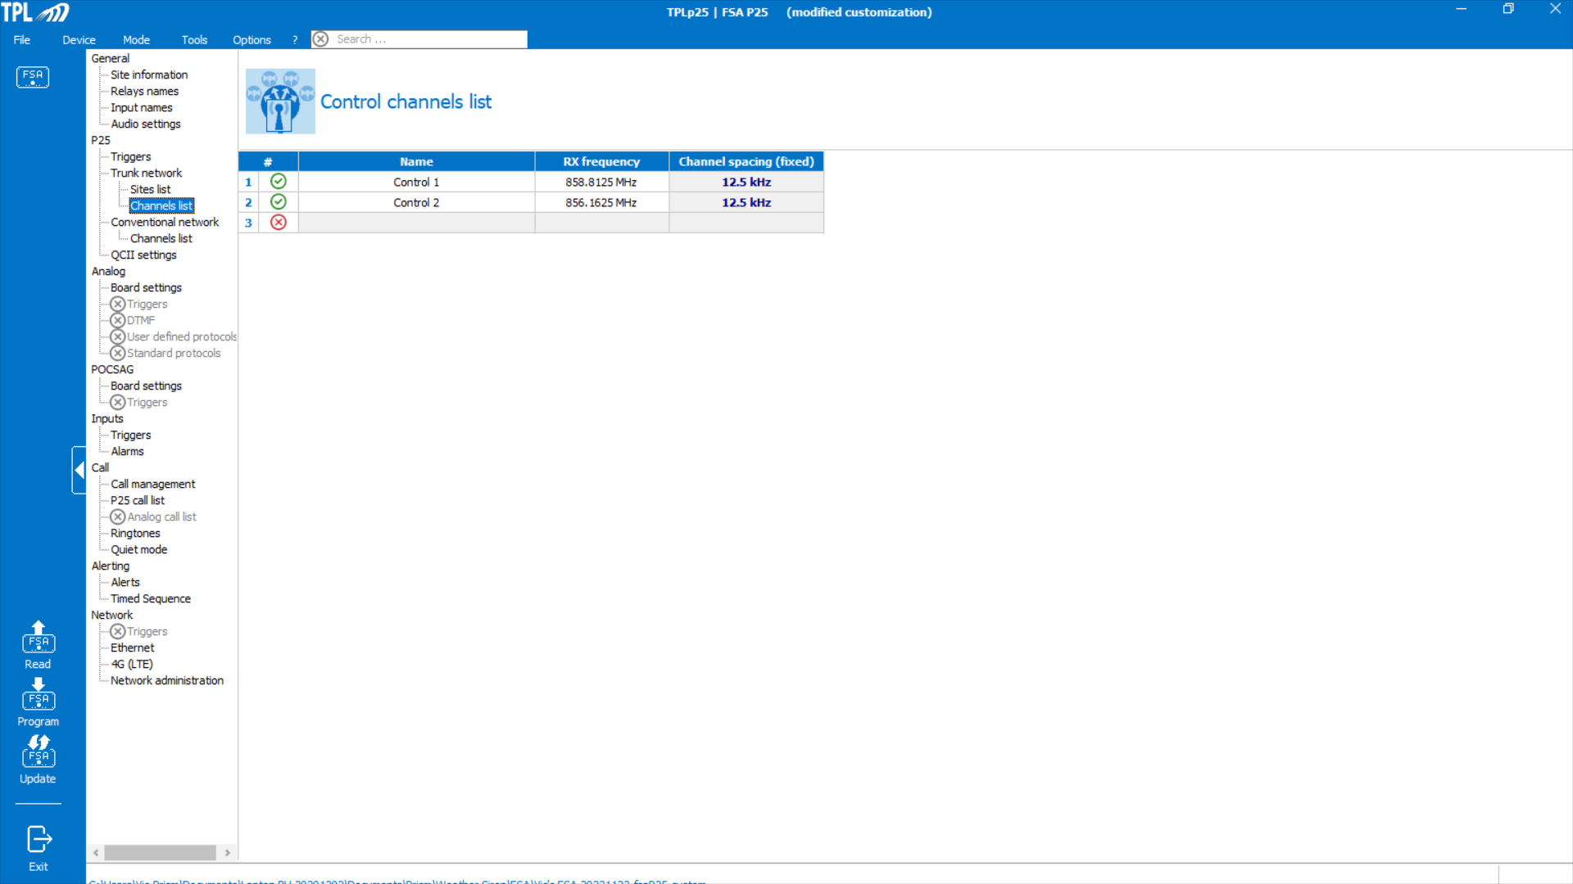
P25 Control Channel List
This is where the Control channels for each Site or Sites is entered. This information has to be supplied by the System Administrator.
Up to 10 Control Channels can be entered.

Slide 11
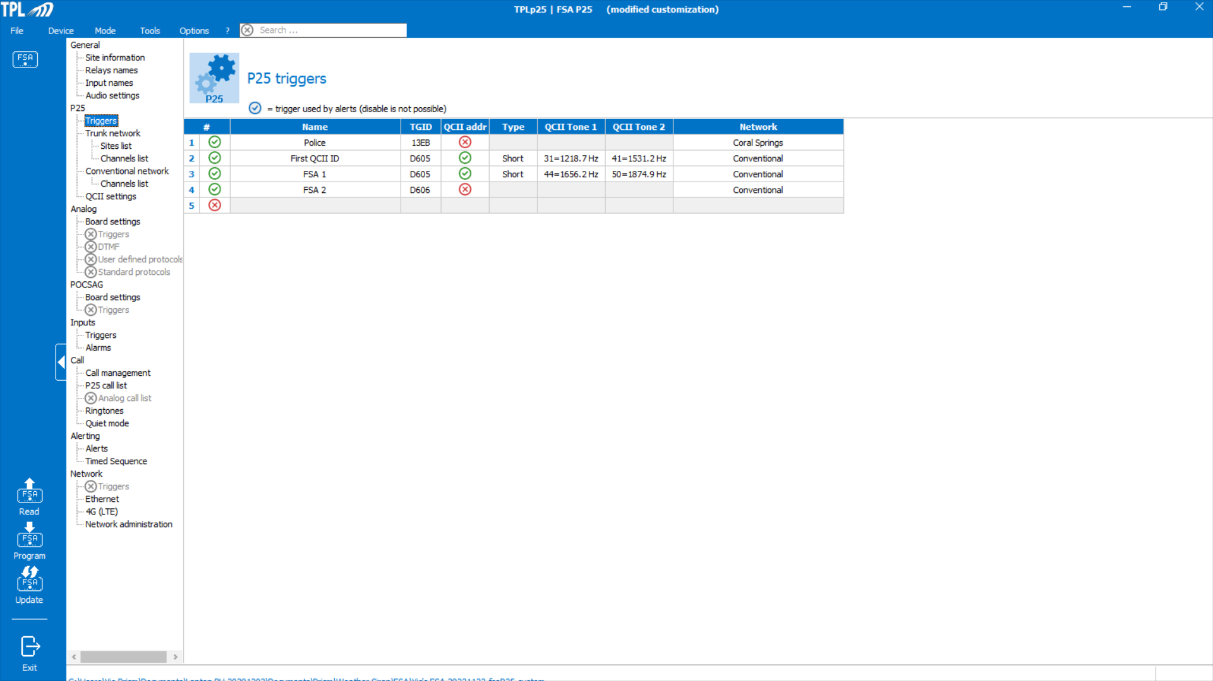
P25 Triggers
Triggers are the TGIDs assigned to the FSA for alerting purposes or ones the FSA will be monitoring (e.g., Fire Ground Traffic). Up to 10 TGIDs can be entered.
The example provided shows TGIDs assigned to a Trunked System and a Conventional one. Typically one does not enable both P25 systems in the FSA because if the FSA is synchronized to a Trunking System it will never scan for P25 Conventional traffic. The only reason to enable both is the rare situation where the Trunking system is down and in this case the FSA will scan between the two systems.
A trigger may support QCII transmissions, both 2-tone or long tone formats. The tones are selected from a pull down menu showing 72 tones. The number proceeding the tone frequency is the Index Value that correlates to the Motorola QCII over P25 tone set.

Slide 12
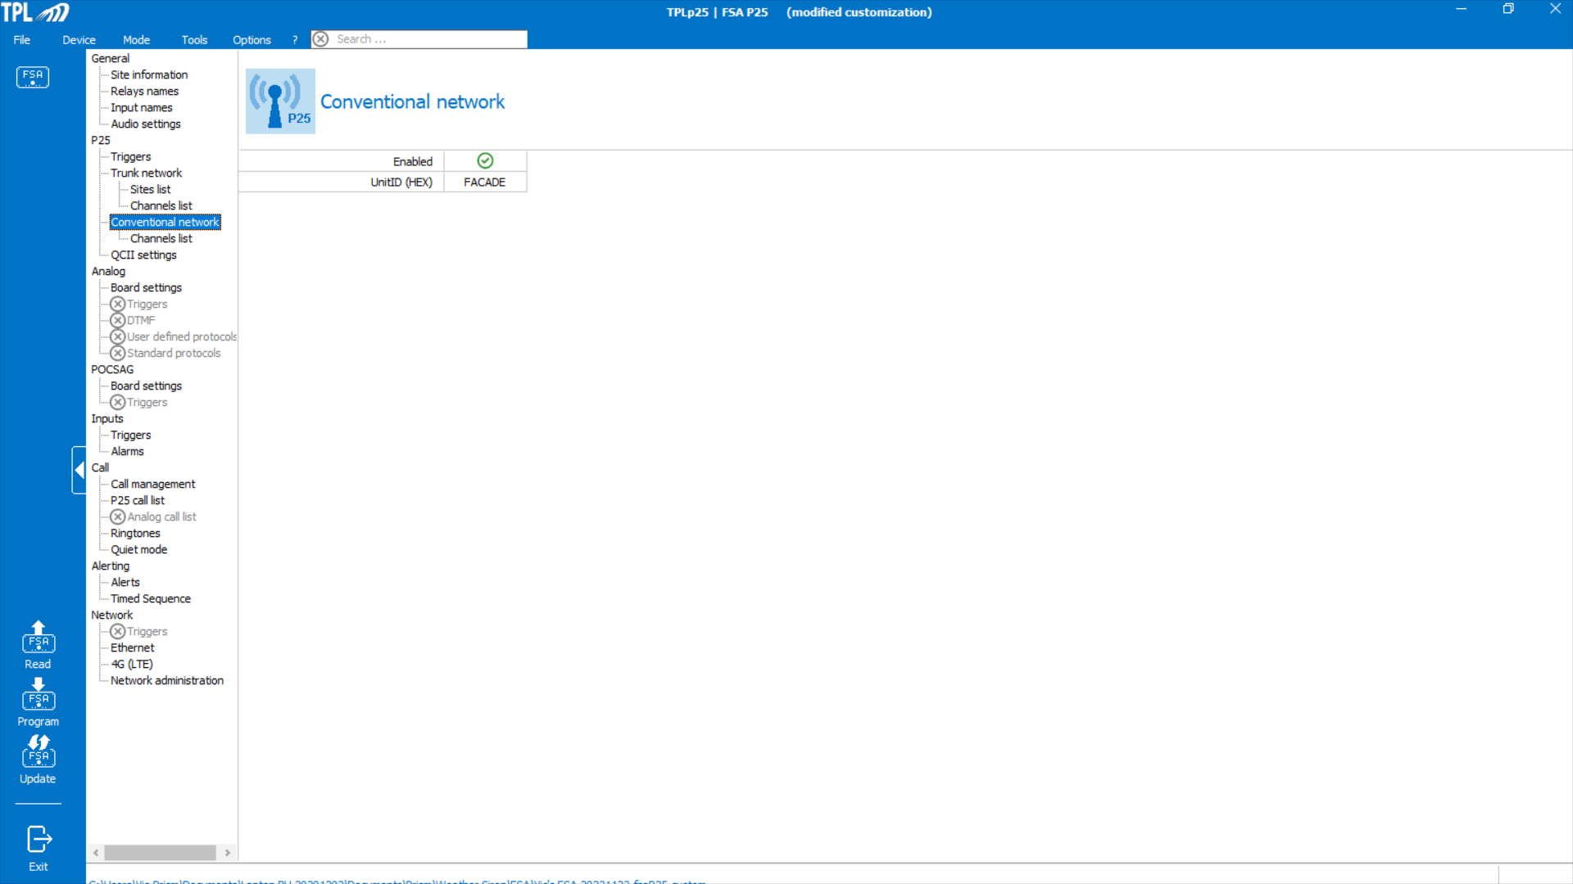
P25 Conventional Network
Here is where one enables the FSA P25 Conventional support. The UnitID should not be changed, leave the default value (FAÇADE).
The previous slide on P25 Triggers is where one defines TGIDs used on the Conventional Network.

Slide 13
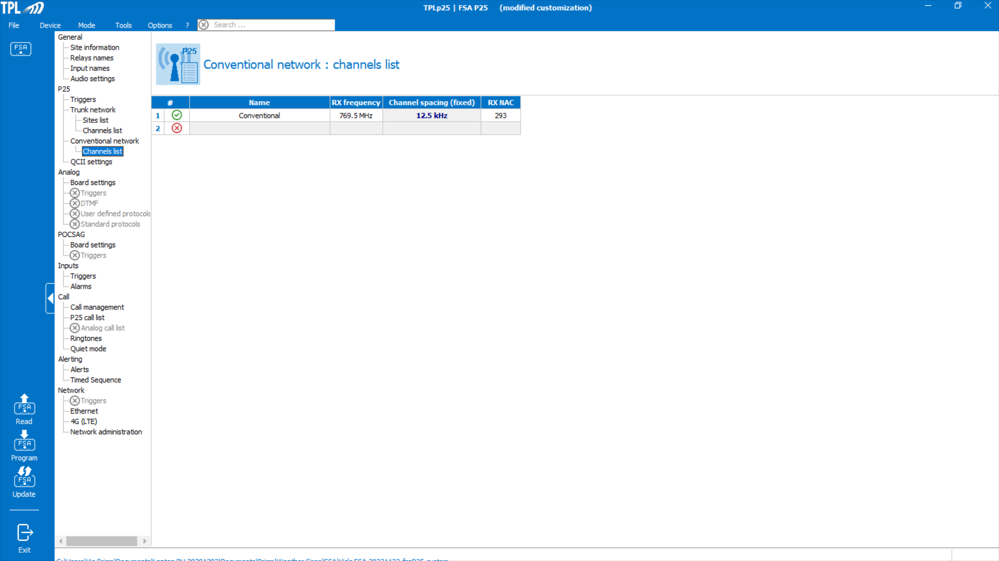
P25 Conventional Channel List
The specific P25 Conventional Channel is entered in this screen.
The Network Access Code (NAC) that defines the P25 Conventional system has to be entered.

Slide 14
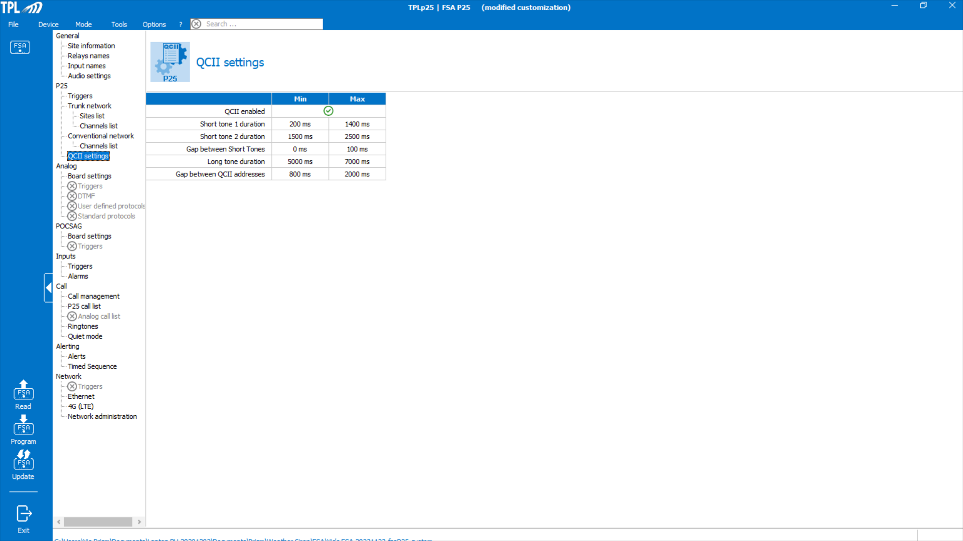
QCII Settings
The FSA supports QCII over P25 for both Trunking and Conventional Systems.
Setting the timing of the tones to be decoded is critical. The default values as shown will cover most applications but, if a decoded tone is shorter than the programmed Min value or longer than the Max value it will not be considered a valid tone.

Slide 15
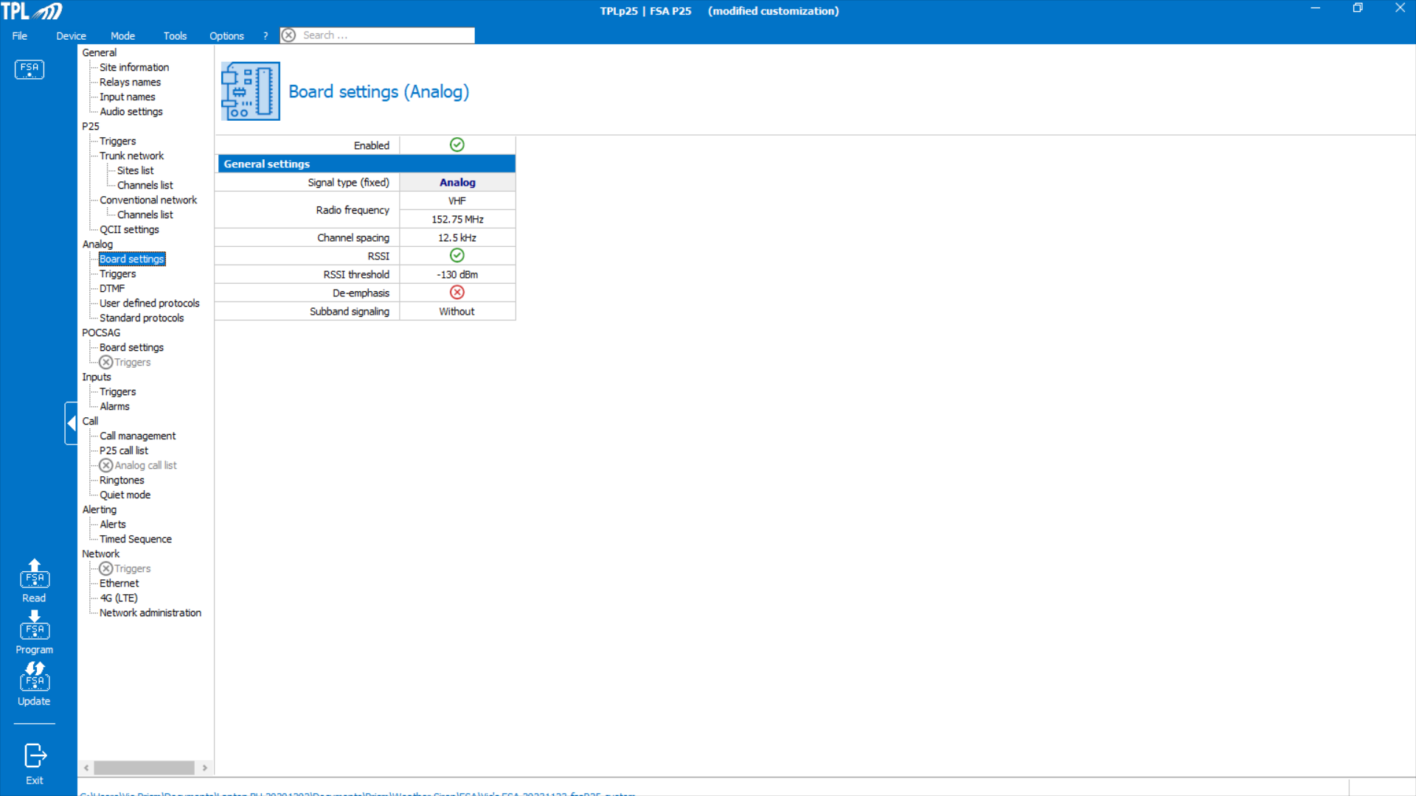
Analog Board Settings
The FSA supports analog 2-tone and DTMF signaling. Key parameters are:
Radio Frequency- VHF (UHF to be a future option) frequencies ranging from 136 to 174MHz can be entered.
Channel Spacing- both 12.5kHz, 20Khz and 25kHz channel spacings are supported.
RSSI- If enabled one can specify the minimum signal strength to allow decoding.
De-Emphasis- Leave disabled.
Subband Signaling- PL or DPL is supported.

Slide 16
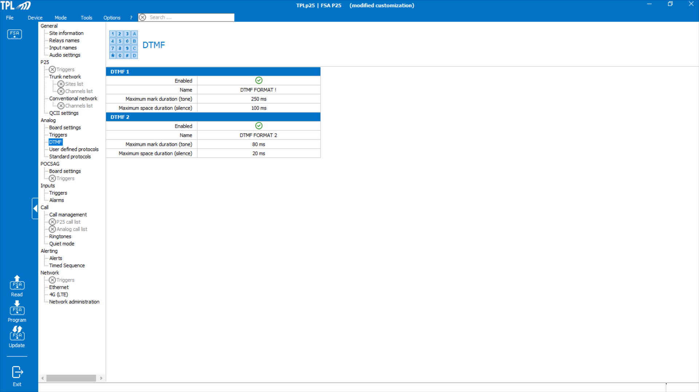
DTMF Settings
If DTMF signaling is used the FSA supports up to two different Signaling formats.
It is important that one knows the timing used in their application and program the FSA accordingly.

Slide 17
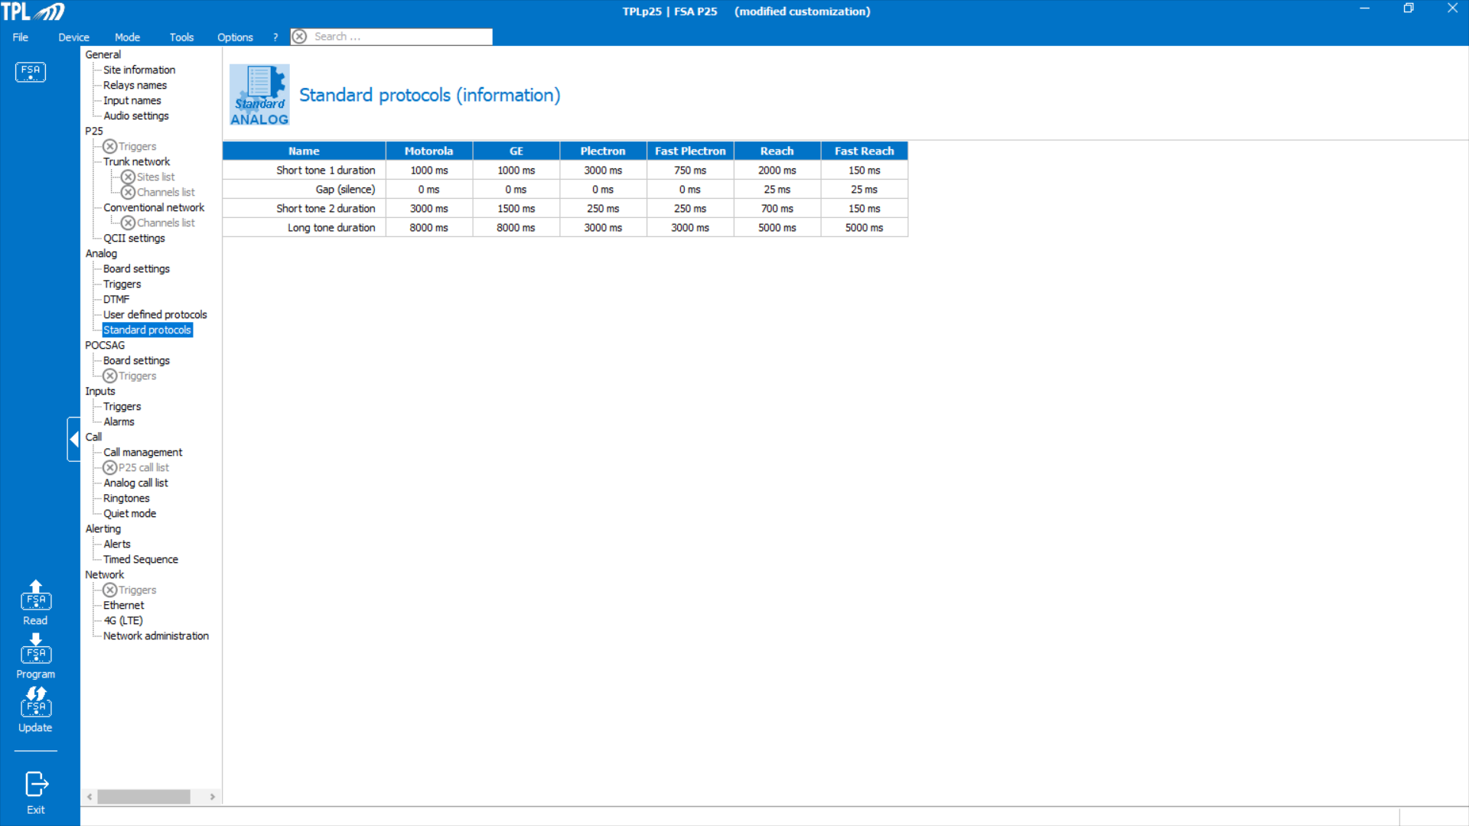
Standard Protocols
This screen is for information only. It provides the different manufacturers’ tone timing.

Slide 18
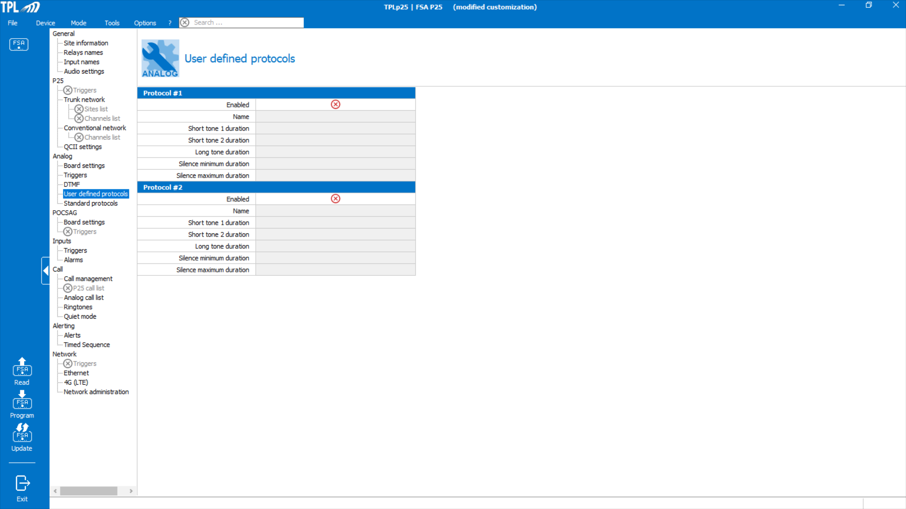
User Defined Protocols
In situations where the FSA’s standard tone timing options are not compatible with what is being used in one’s application, this screen allows for the creation of up to two different custom settings.

Slide 19
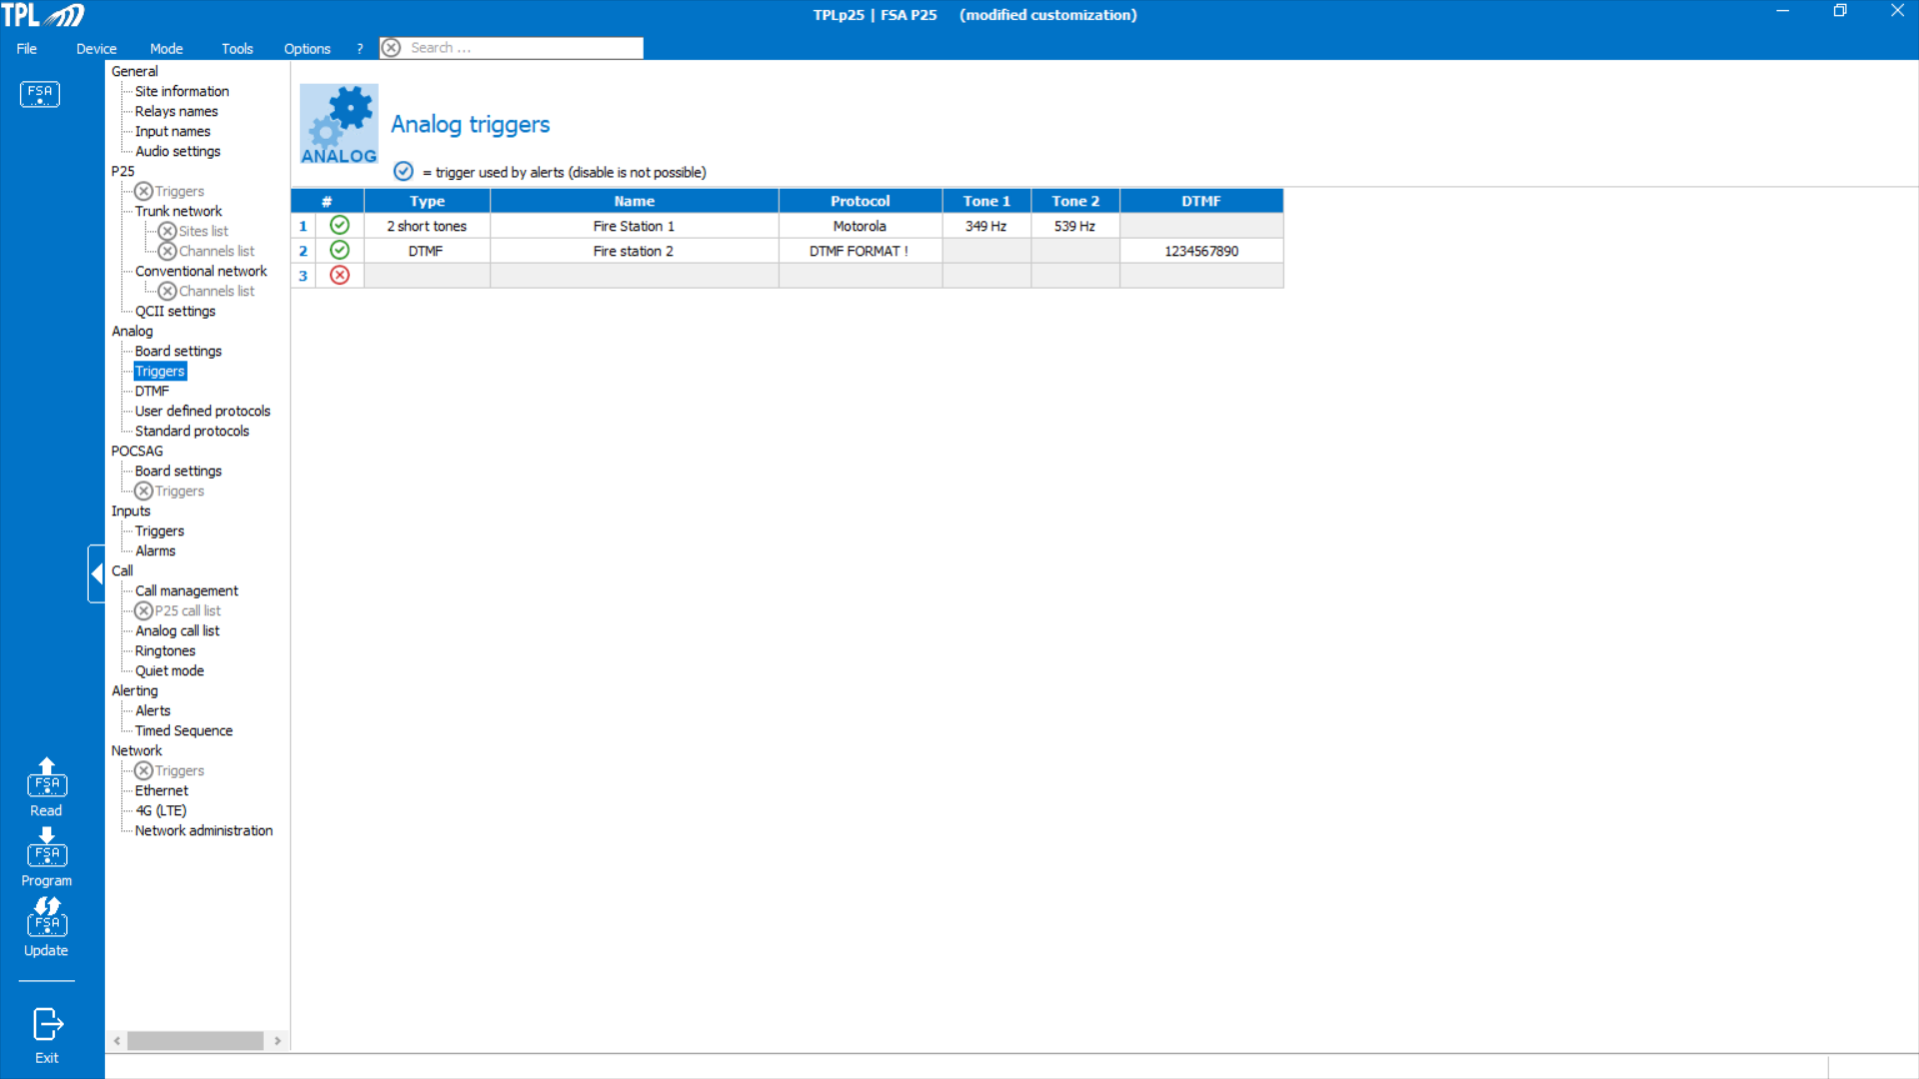
Analog Triggers
The FSA supports up to 10, 2-tone and DTMF, triggers.
Type- Choose between:
  2 tone or Single long tone signaling formats.
  DTMF Format
Name- specify what the trigger is used for.
Protocol:
  for 2-tone triggers the FSA supports a number of manufacturers’ specific tone timing and tone groups or customized tones when User Defined protocol is specified.
  For DTMF, up to two formats are allowed.
Tone 1 and 2- a pull down menu allows one to choose the desired Tone A and Tone B or Long Tone.
DTMF- up to a 20 Digit DTMF code is supported.

Slide 20

POCSAG Settings
The FSA does support POCSAG signaling which can be used to activate or cancel select Relays.
Radio Frequency:
  Both VHF and UHF bands are supported.
  VHF band 136-174MHz and UHF band 434-470MHz are supported.
Channel Spacing choices are 12.5, 20 or 25 kHz.
RSSI- If enabled one can specify the minimum signal strength to allow decoding.
Baudrate- 512, 1200 and 2400bps settings are supported.
Reverse Polarity- disable this.

Slide 21
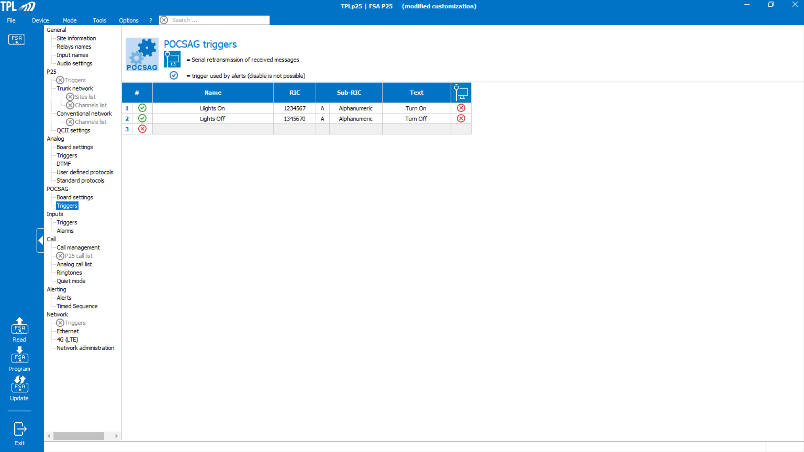
POCSAG Triggers
Name- description of what the trigger is used for.
RIC- is Radio Identification Code or cap code. It is a 7 digit value.
Sub-RIC- need to specify the sub address (A,B,C or D) and whether it is a Tone Only, Numeric or Alphanumeric message.
  If alphanumeric, one can specify the message on which the Trigger will activate.
Serial Retransmission of Received Messages- this feature is not supported at this time.

Slide 22

Input Triggers
Input triggers can activate relays. However, an Input to be used for Quiet Mode (refer to slide XX) control should not be listed under Triggers.
An input trigger can be set to activate upon detection of a closure or an opening.

Slide 23

Input Alarms
Input alarms is a future feature. This will work when the IP or 4G/LTE remote server interface is available.

Slide 24
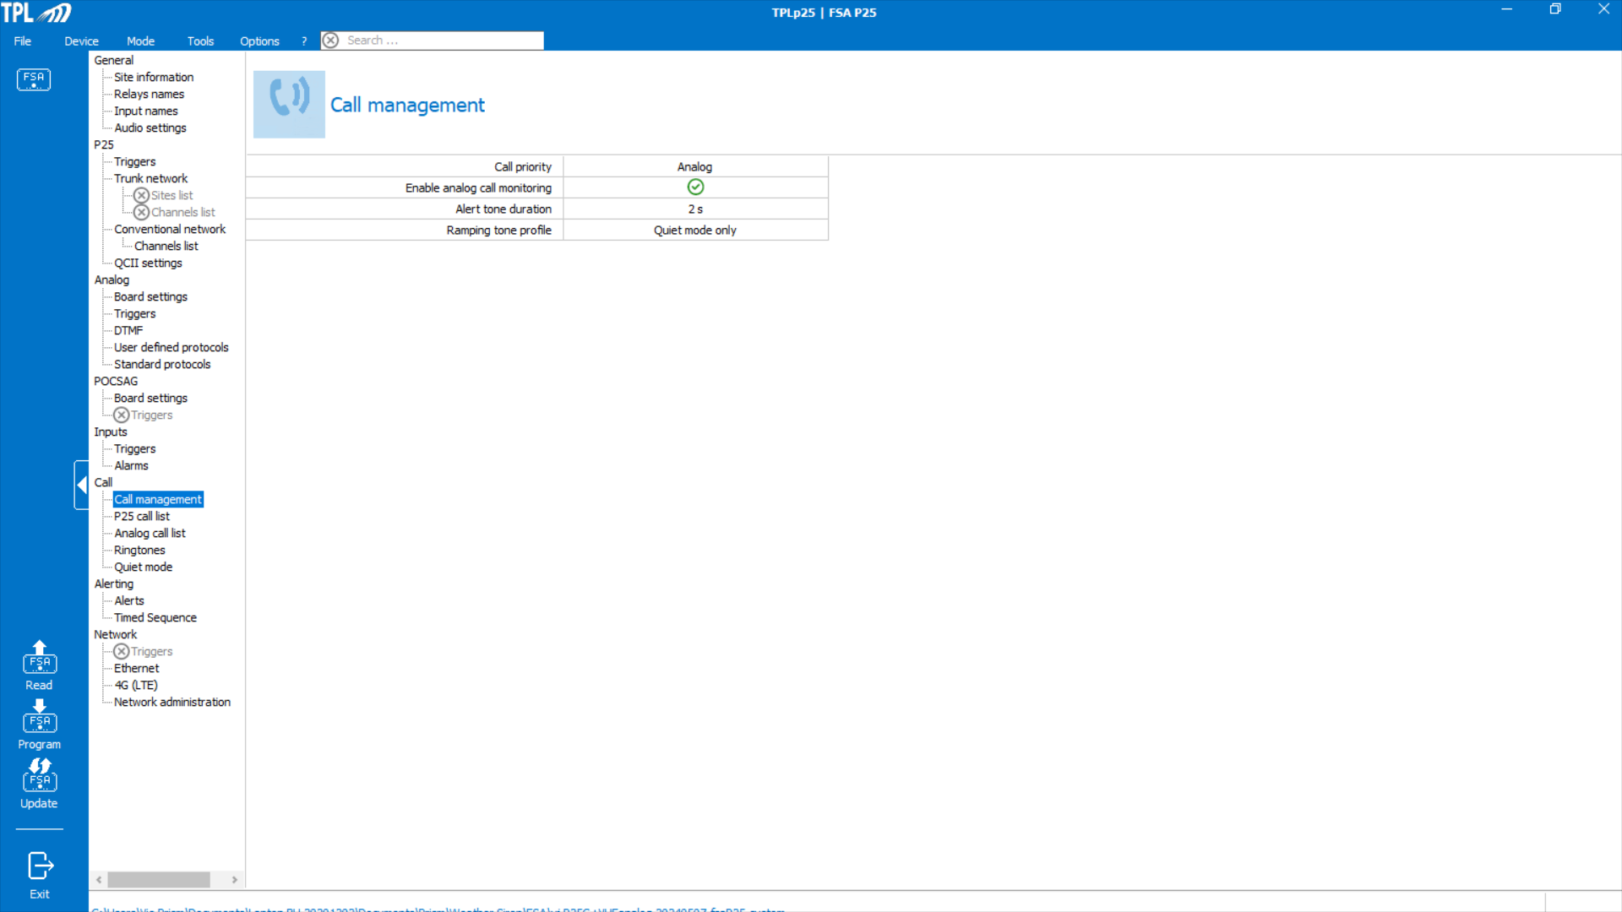
Call Management
Call Priority can be set for P25 or Analog. If set for P25 then any incoming P25 call will interrupt an active Analog call.
If one wants to monitor Analog calls then enable this setting.
The Alert Tone duration is set in 0.1 second increments up to a max of 6 seconds. This setting is used for both P25 and Analog alerting designated calls.
Alerting tones can be set to ramp up in volume all the time, during Quiet mode only or never.

Slide 25
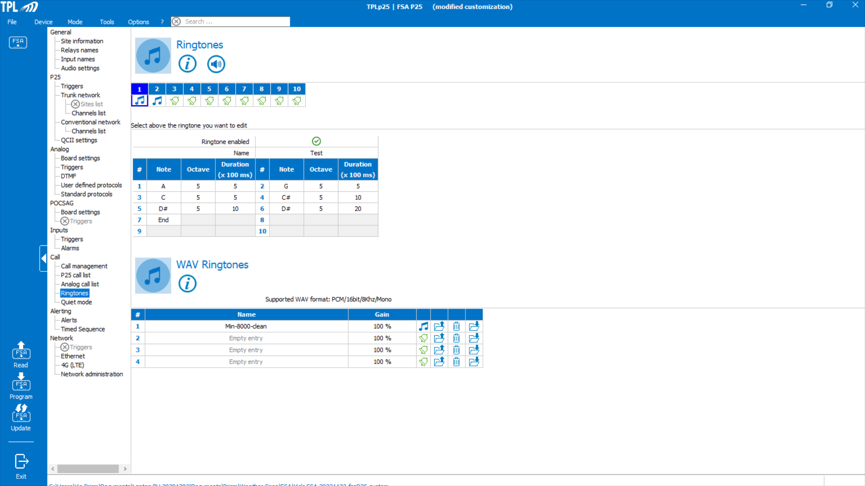
Ringtones
Here is where one can create special ringtones (up to 10) or download up to 4-WAV files.
Any created ringtone can be listened to by selecting the Speaker Icon.
Any WAV file can be listened to by selecting the musical note icon.

Slide 26
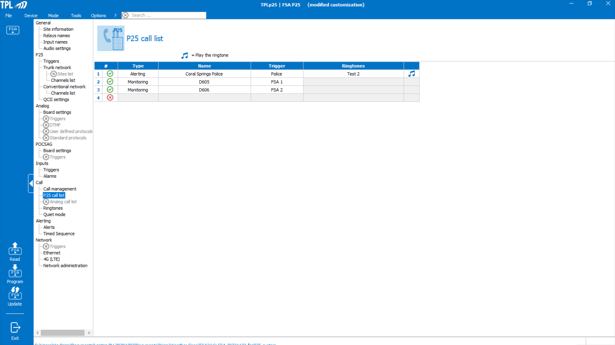
P25 Call List
In this screen one lists all P25 calls to be monitored or to be alerted.
Alerting calls should be at the top of the list.
For Multi-select/ Simo-select applications, the call that will be multi-selected has to be the first one listed.
For Alerting Calls, one can select the desired Ringtone using the pull down menu with a list of the options.
By selecting the musical note icon one can listen to the selected Ringtone

Slide 27
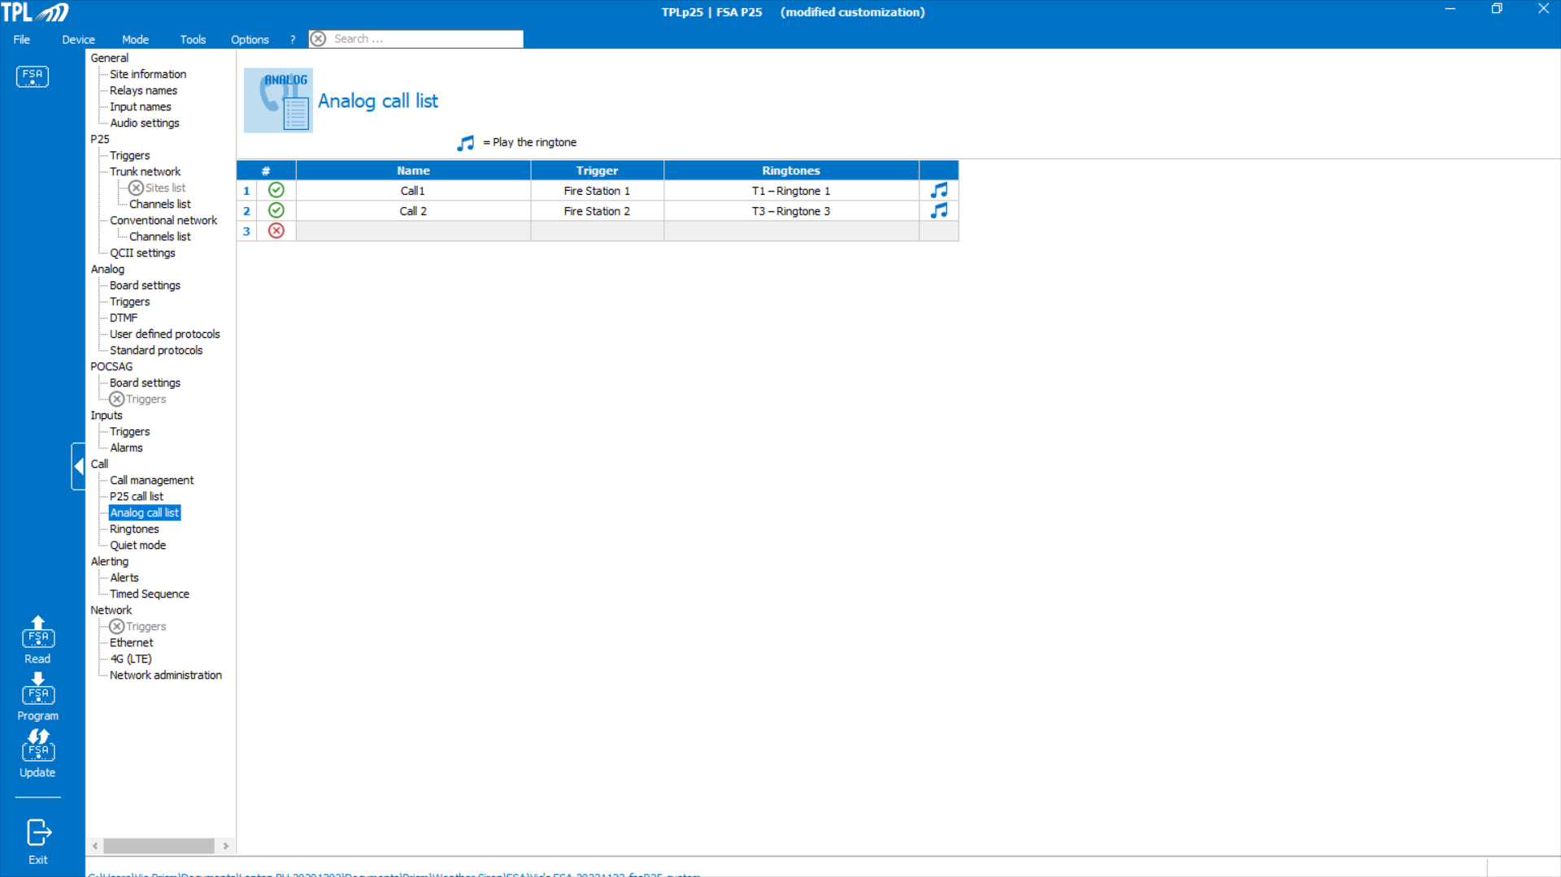
Analog Call List
Here is where one lists all Analog calls to be alerted.
One can select the desired Ringtone using the pull down menu with a list of the options.
By selecting the musical note icon one can listen to the selected Ringtone.

Slide 28
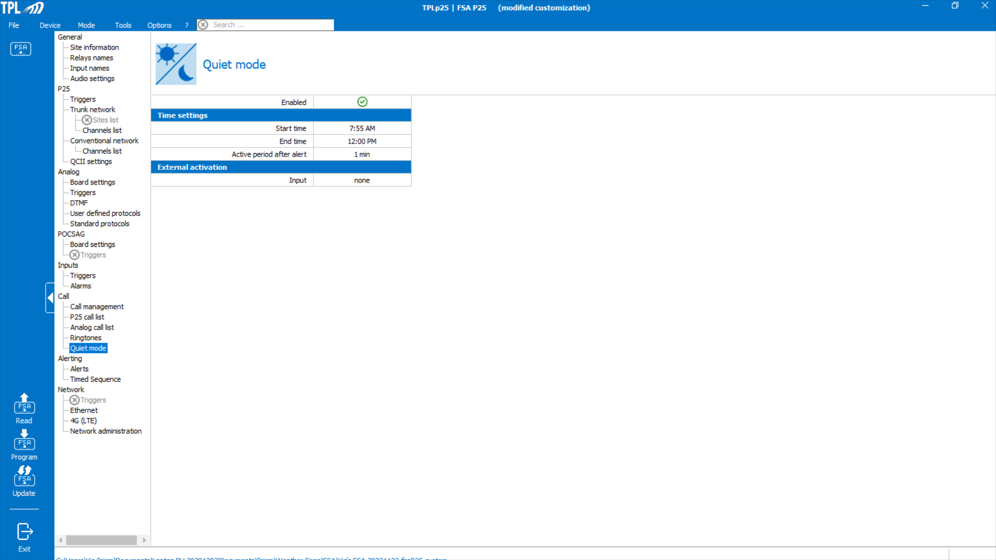
Quiet Mode
Quiet Mode allows for an On and Off Duty behavior. During On Duty all analog or P25 calls designated for monitoring or alerting will be heard over the front panel speaker (if enabled) and the 600 Ohm output. In Off Duty the FSA behaves similar to the Minitor pagers enabled for “Selective Call With Revert”.
One can set up Quiet Mode on a timed basis. This is where setting the correct Time Zone is important (refer to slide 3).
Or, it can be set up to be enabled manually through one of the Inputs.
In either case, when in Off Duty after the FSA receives an Alerting call it will go into monitor mode (up to 10 minutes) and listen to all traffic on the analog channel or all P25 calls designated for Monitoring.

Slide 29
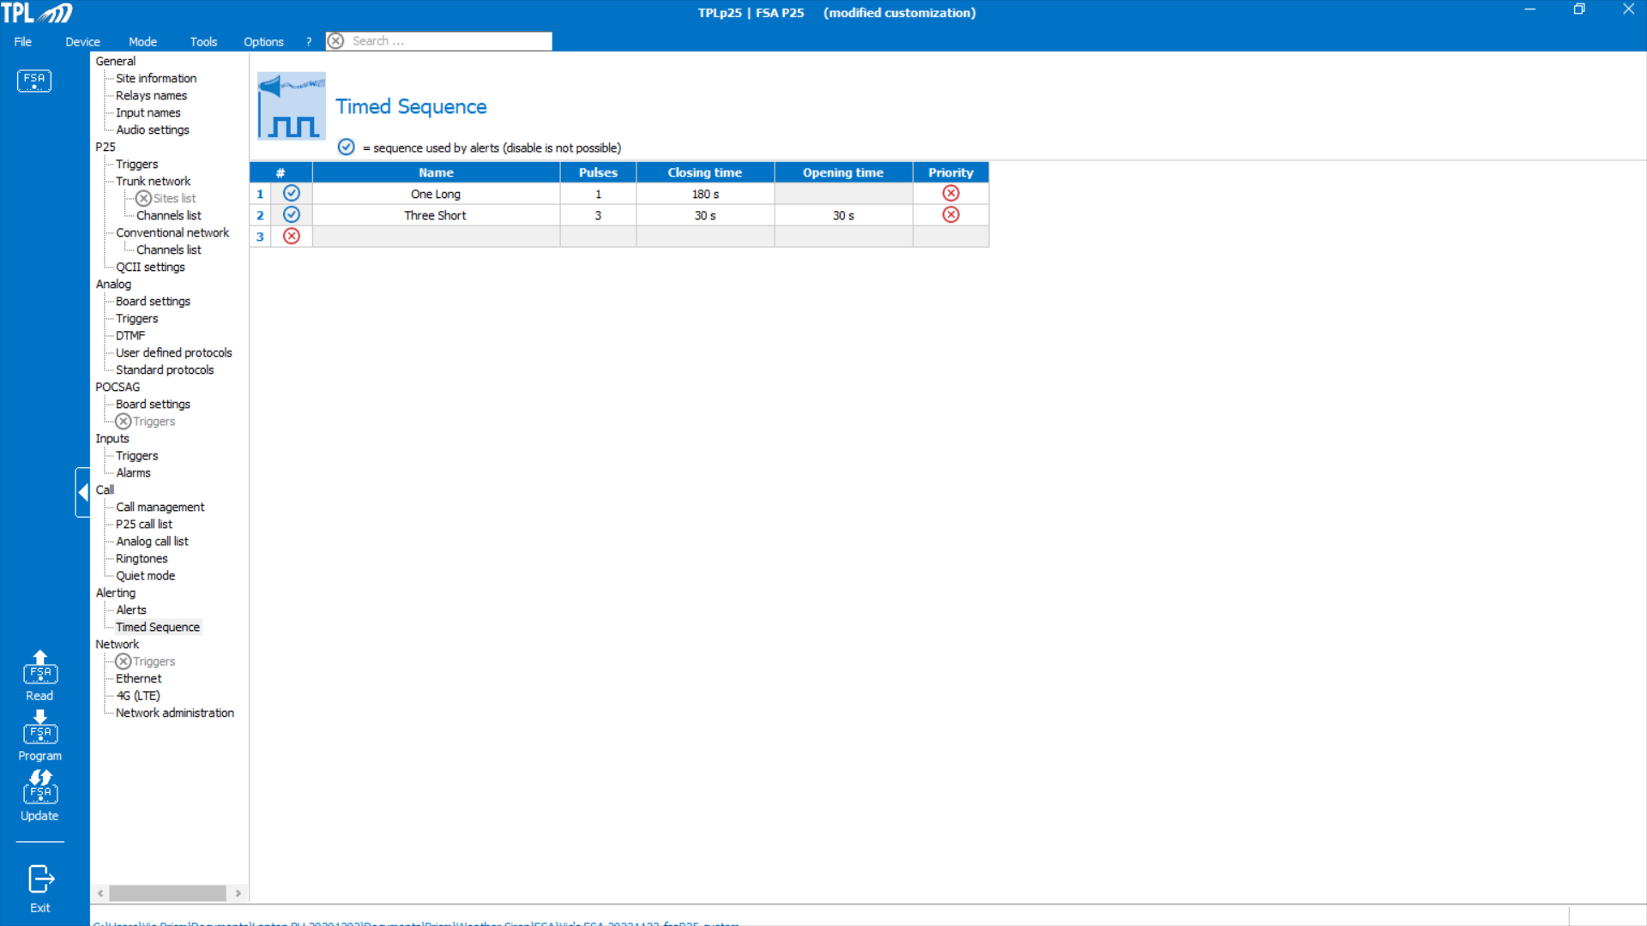
Timed Sequences
This is the screen where one creates the relay on/off control sequences.
There is a Priority setting which, if enabled, means any Trigger that is received and is associated with the priority timed sequence will interrupt the other timed sequences.

Slide 30
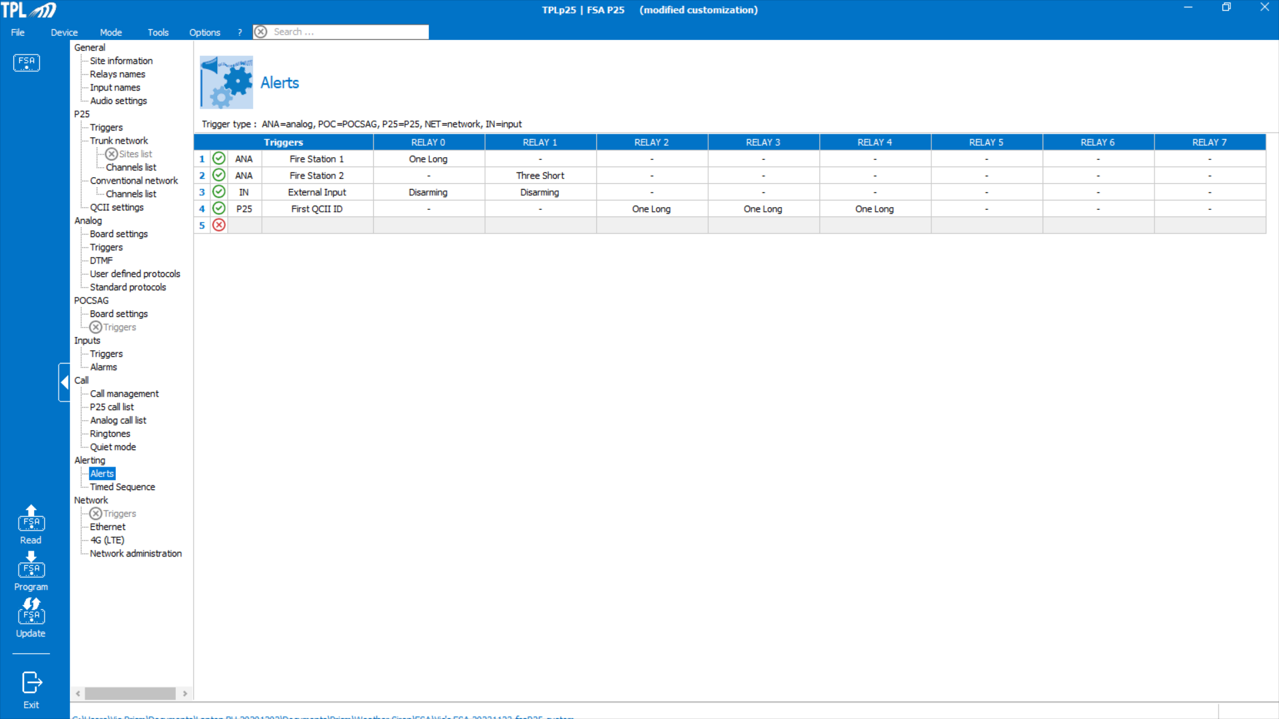
Alerts
In this screen one can assign the different Triggers (P25, Analog, POCSAG and Inputs) to activate a relay or multiple relays using the created Timed Sequences.
In the example provided a Trigger is used to Disarm a relay.

Slide 31
Network
The Network settings, supporting IP and 4G/LTE interfaces, is a future feature.

